Slide 1

Genomic Surveillance Applications
AAVLD 2024
Michael Zeller

Slide 2
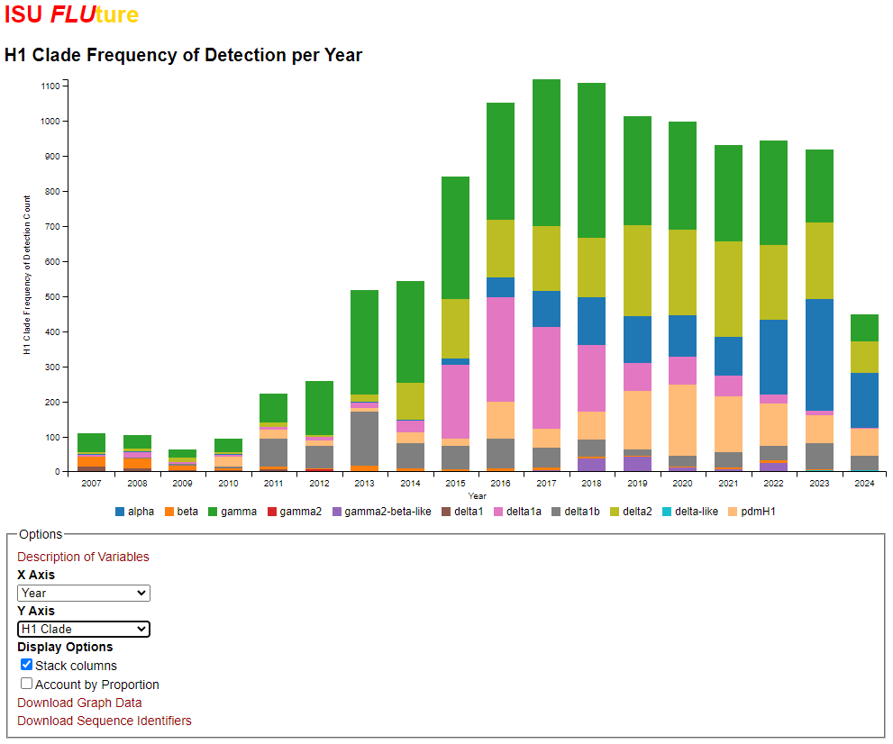
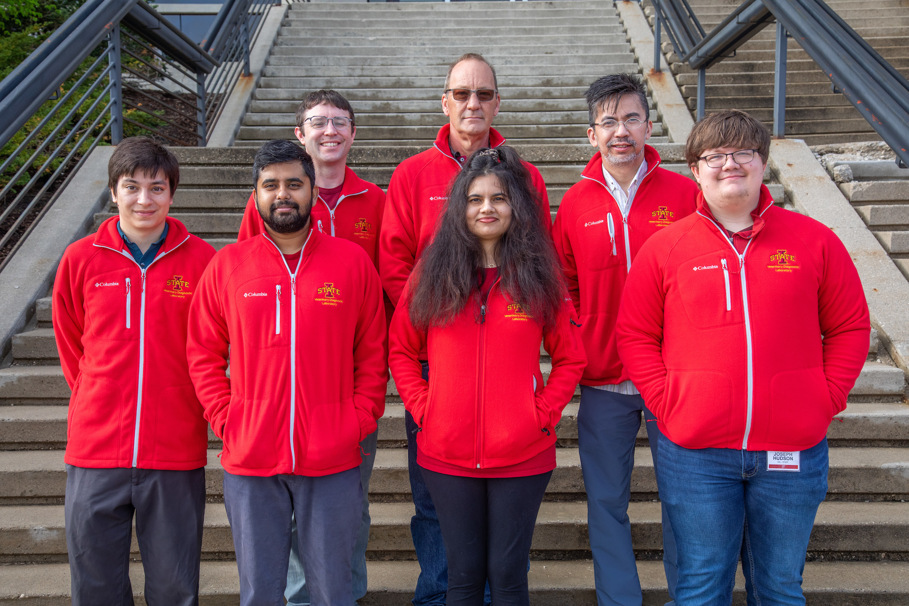
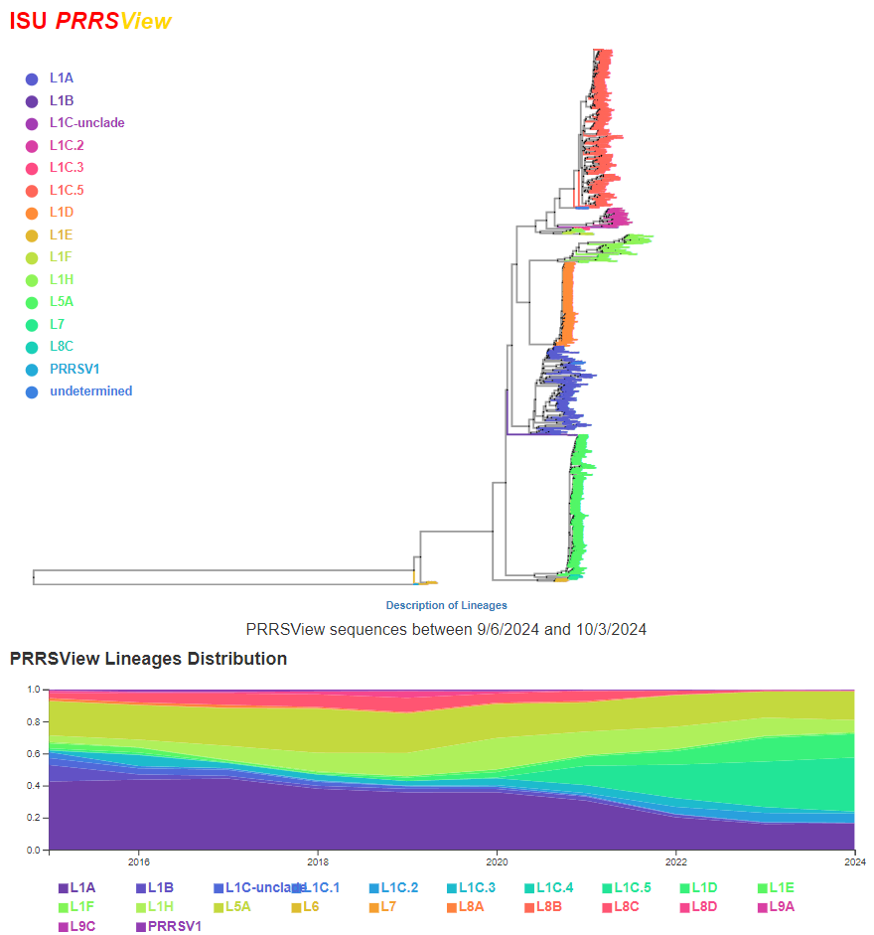
Introduction
(VDL IT Team. ISU VDL Public Material, 2023)
Notes:
A quick introduction for myself, I am Michael Zeller
I am a bioinformatician at the ISU VDL.
The picture shows the IT team for the diagnostic lab, I am the person wearing red in this photo.
I also manage the ISU FLUture and ISU PRRSView projects

Slide 3
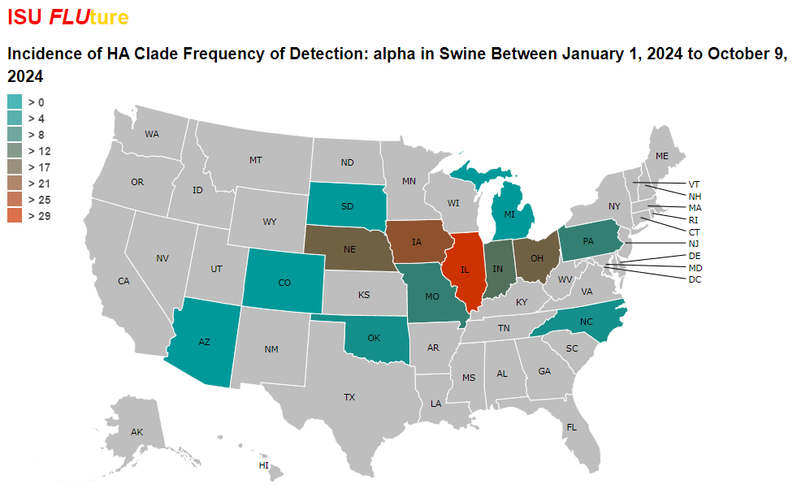
Purpose
How to get more insight from genomic data?
Understand movement of disease
  Production system
  Regionally
Identify changes in disease genetics
Notes:
Purpose of this talk is to answer question how do we get more insight from our genomic data?
How can we use this data to understand movement of the disease
How can use it to identify genetic changes in the disease
Before we get into some examples of the application, I want to talk about foundational setup for surveillance.
More and more data is being tracked and log, but surveillance happen efficiently without modernizing data capture.

Slide 4
Data ingestion
Establish a data stream
  Submission form
  Online entry forms
  Sample processing
Add value to data
  Assigning lineages to seqs
  Discretizing geolocation
  Binning CTs
Data ingestion
Standardization
Storage
Surveillance
Notes:
I will break this down into four steps, ingestion, standardization, storage, and surveillance
The first step is data ingestion, which is establishing a common entry point for the data through a data stream.
Physical forms
Digital forms
Instrument data entered into LIMS
This data can have value added, tacking on metadata such as
CT values
geolocation of the sequence
assigning lineages.

Slide 5
Data Standardization
Enforcing names/standards for downstream analysis
  Remove variation from entries
  Ease querying
  Decrease overall data footprint
  Increase reliability of dataset
Data ingestion
Standardization
Storage
Surveillance
Notes:
The next step in our process is data standardization.
For automation and programmatic surveillance, this step is essential.
It happens on multiple levels, typically through a process of normalization.
An example would be state name for a case. There are multiple ways to write North Carolina, but enforcing a single uniform normalized reference to this state opens up a number of pathways for automating tracking.
Likewise, can apply to specimen names, and other categorical variables. Also applies to discrete and continuous variables. Forms submitted without a weight can be stored as -1 or 0, rather than the multitude of other notations.
This removes variation from entries
Eases querying
Decreases overall data footprint by removing redundancy
And increases reliability of the dataset

Slide 6
Data Storage
Excel sheets are suboptimal
  Do not scale effectively
  Hard to manage programmatically
  Does not centralize data
Relational databases
  Better centralization
Cannot monitor what is not tracked
Data ingestion
Standardization
Storage
Surveillance
Notes:
Finally, we need to store this data so it is readily accessible for surveillance
Spreadsheets are suboptimal for this process
Relational databases are better for storing data, designed for multiple person access
Centralized
For surveillance, you cannot track what you are not monitoring.

Slide 7
Genomic surveillance
Passive
  Checking trends
  Need to visualize/tabulate
Active
  Set instruments in place
  Send alerts for certain trends
Build a landscape conducive for surveilling
Data ingestion
Standardization
Storage
Surveillance
Notes:
That brings us finally to being able to perform genomic surveillance
Once our data is standardized in a database, it is conducive for searching out trends of interest
We have two modes of surveillance from the computational perspective;
Passive surveillance, where we are looking at graphs and tabulations manually from time to time and notice something of interest
Active surveillance, where we built programmatic infrastructure to monitor a specific question we have in mind
What is important up to here is to build a landscape that is conducive for surveilling what you are specifically interested in

Slide 8
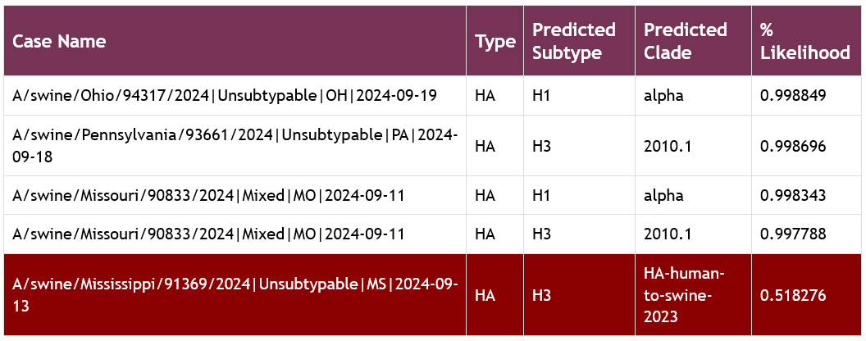
Human H3 influenza spillover detection
Ingesting sequence, state, and lineage data
Machine learning aided surveillance
Quickly identify spillovers
Notes:
One good example of active genomic surveillance is detection of hu-spillovers.
Our data ingestion for this is IAV cases with their sequences. We append their lineage via automated machine learning, as well as their state. Lineage and state names are standardized before they are stored in our database.
Finally, newly classified cases are sent out via a nightly email, with irregular sequences highlighted.
This allows us to quickly identify when irregular sequences make it into our system, and we can follow them up for investigation.

Slide 9
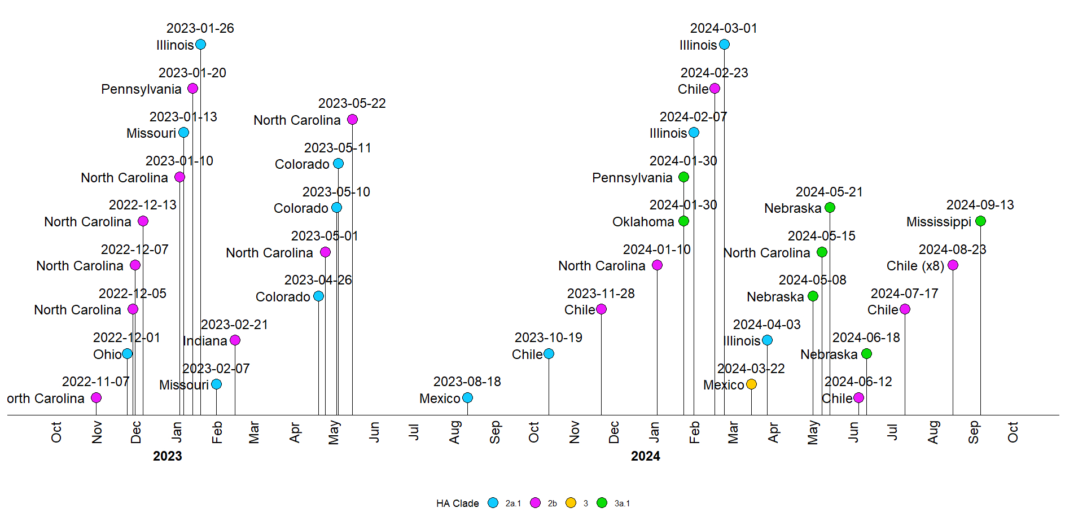
Human H3 influenza spillover detection
Triggered research investigation
Multiple cases throughout the western hemisphere
Currently at 42 distinct detections
Across 4 human lineages
Notes:
The volume of these sequences has triggered a research investigation, where each time we detect a spillover case, we are adding it to a list for a subsequent investigation

Slide 10
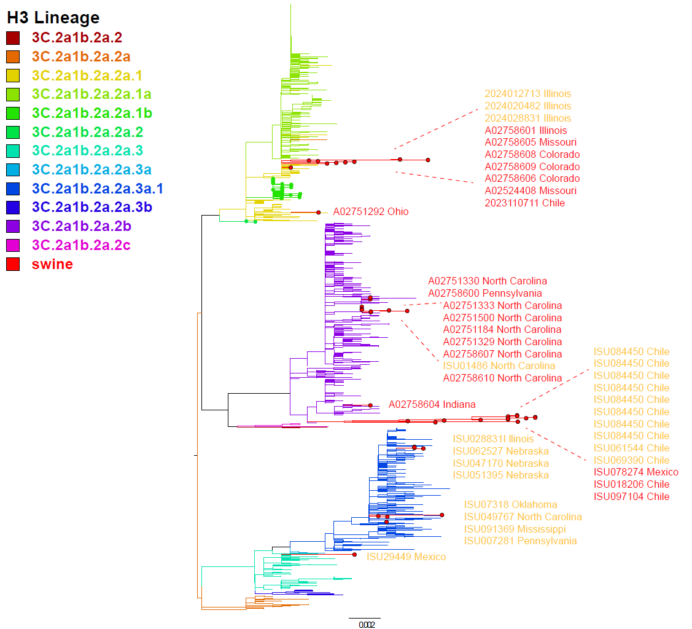
Human H3 influenza spillover detection
Likely swine-to-swine transmission
Establishment in different locations
Risk of endemic spread
2a.1
2b
3a.1
3
Notes:
Some lineages are regionally constrained
Strong likelihood of pig-to-pig transmission – endemic within specific production systems
And if it can jump out of a production system, there is a risk of endemic spread within swine as a whole

Slide 11
Increased detection of H1N1 alpha (1A.1.1)
Year | H1N1 | H1N2 | Total
2019 | 1 | 89 | 90
2020 | 1 | 67 | 68
2021 | 16 | 45 | 61
2022 | 91 | 59 | 150
2023 | 149 | 73 | 222
Notes:
Another example from influenza surveillance is the reassortment of alpha influenza from H1N2 into H1N1
Alpha 1A.1.1 is the dominant H1 lineage in US swine right now
Prior to 2020, most detections were N2.2002B
Only 16 cases in 2021, dominant detection in 2022 with 91
Not only has alpha sequences increased, but alpha related cases are being associated with H1N1 subtyping pcrs.

Slide 12
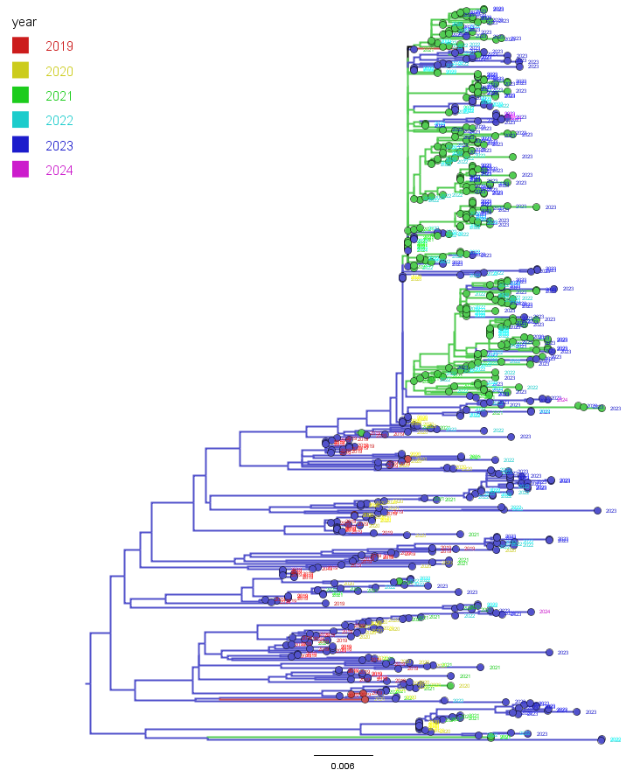
Alpha (1A.1.1) detections as subtypes
H1N1 alpha are more genetically similar than H1N2
Interspersed with N2 reassortment
H1N1
H1N2
Notes:
Again, we follow this up with phylogenetic investigation
Phylogenetic tree of alpha from 2019-2024
Annotated by their subtypes, H1N1 and H1N2
H1N1 are genetically similar, short branch lengths at the top of the tree (20nt mt)
Reassortment back to N2 is common in this section of the tree

Slide 13
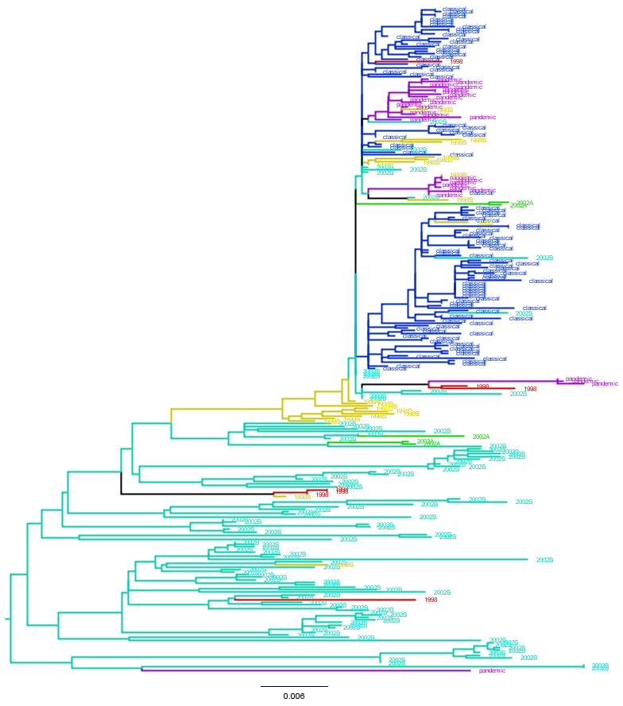
Alpha (1A.1.1) detections with paired neuraminidase
Historically paired with N2.2002B
Short bridge period with N2.1998B
N1 region primarily N1-classical, growing number of N1-pandemic
Interspersed with multiple N2s
N1.PDM09
N1.Classical
N2.1998B
N2.2002B
Notes:
Break it down one more level
Thanks to USDA program, we have NA sequences
Subsampling to sequences with NA
Historically primary N2 was N2.2002B
There was a short bridging step were N2.1998B
N1 region was primarily classical N1, but there is a growing number of N1-pdm
Periodic reassortment with N2s in 1998B, 2002A, and 2002B

Slide 14
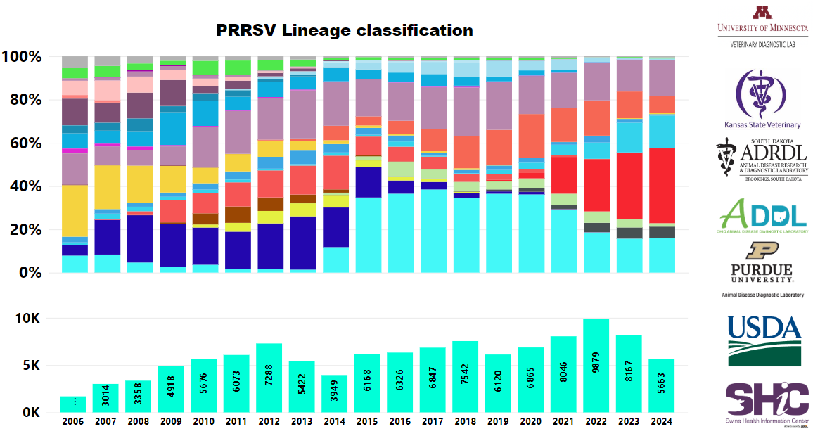
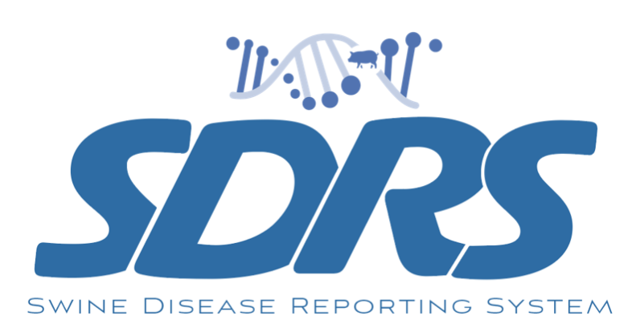
Rise of PRRSV lineages
Continued Ingelvac MLV usage (L5)
Increased Prevacent use (L1D)
L1C.5 is dominant
L1C.2 is increasing
L1A detections waning
Notes:
We will switch over to another virus in swine, PRRSV. The SDRS project provides capable tools for handling genomic surveillance, which we can use to view trends. On this graph, of PRRSV Lineage detections over time, there are a number of interesting trends we can observe.
The large red group is L1C.5, which is the dominant detection
The prior dominant lineage, L1A is waning
We see a notable increase in L1D, shown in blue, and this indicates to us that the use of Prevacent has been increasing recently
The other MLV in major use, Inglevac MLV which is an L5, has consistent detection
The last trend of interest is that we have a gray bar that is increasing over time, albeit slowly.
This is the L1C.2 lineage, which is having a slow increase in the number of detections.

Slide 15
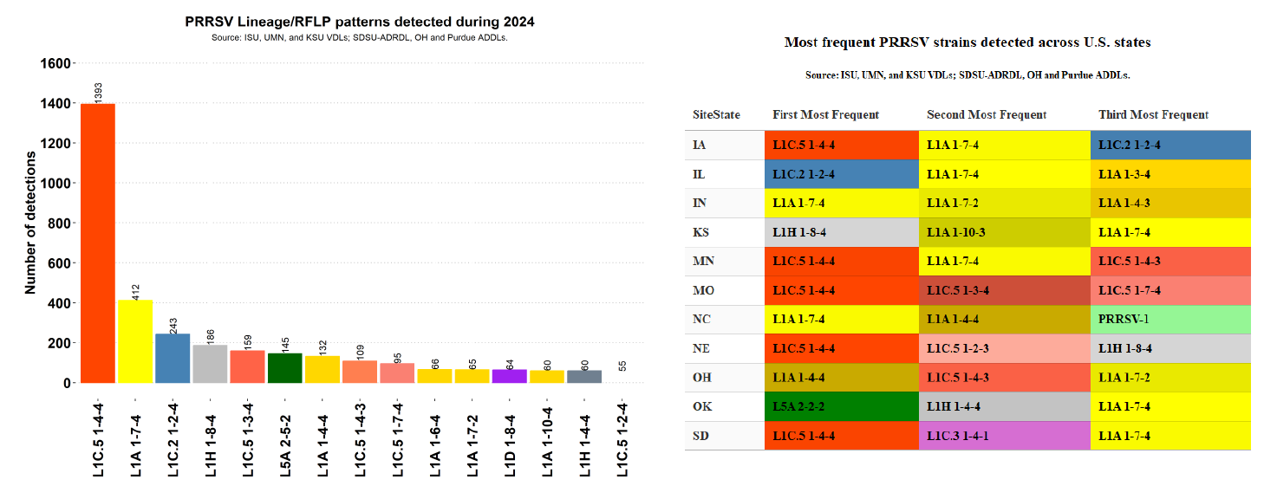
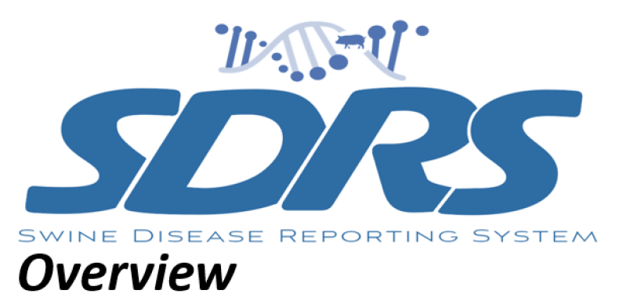
Rise of PRRSV lineages
Notes:
The larger SDRS consortium does deeper genomic analysis, where they also relate the location of detection to the lineage-RFLP combo they are observing.
As shown prior, L1C.5 and L1A are the largest lineages in observation (red and yellow)
There are a notable number of detections of L1C.2, and they are now apparent in two states, Iowa and Illinois

Slide 16
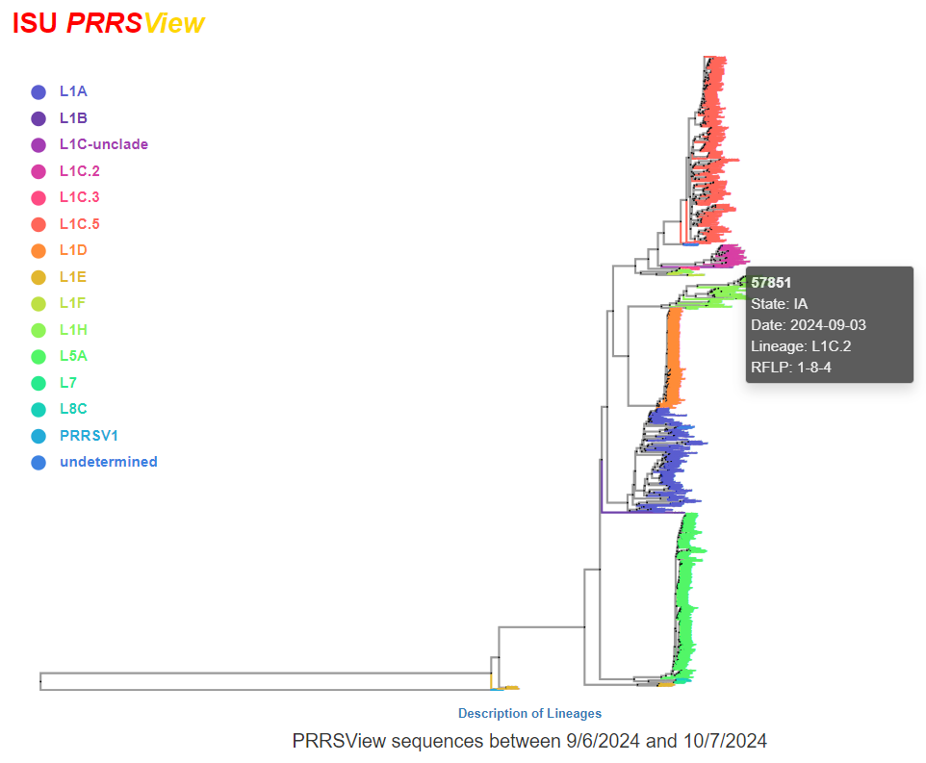
Rise of PRRSV lineages
Trends can be checked against other genomic surveillance tools
Different aspects of same picture
  SDRS
    Balanced, national trends
  ISU PRRSView
    ISU VDL perspective only
Notes:
Perhaps we should monitor L1C.2 more, it may become dominant
For PRRSV, multiple tools, such as PRRSView
L1C.2 has a clear depiction on the tree that is significant
To relate the differences in these tools
SDRS ingests national data from multiple d-labs
PRRSView only provides data seen at the ISU VDL

Slide 17

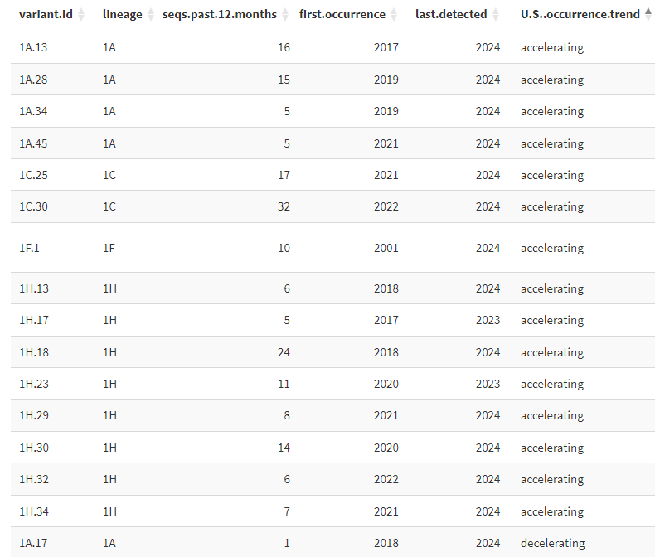
Rise of PRRSV lineages
UMN, Kim VanderWaal
Variant monitoring
  Fine scale classification
  Bypasses classifying clades
Identify groups that need further monitoring and characterization
Notes:
One other monitoring platform available, PRRSLoom variants
From Kim VanderWaals group
Data ingestion is from the MSHMP project, sequences, locations, adding variant information to lineage
Monitoring data shown here, they can track which variants are accelerating, decelerating, holding steady, or are extinct.
Will regularly hold meetings to decide when to call something a new lineage, which will help us stay on top of PRRSV diversity

Slide 18
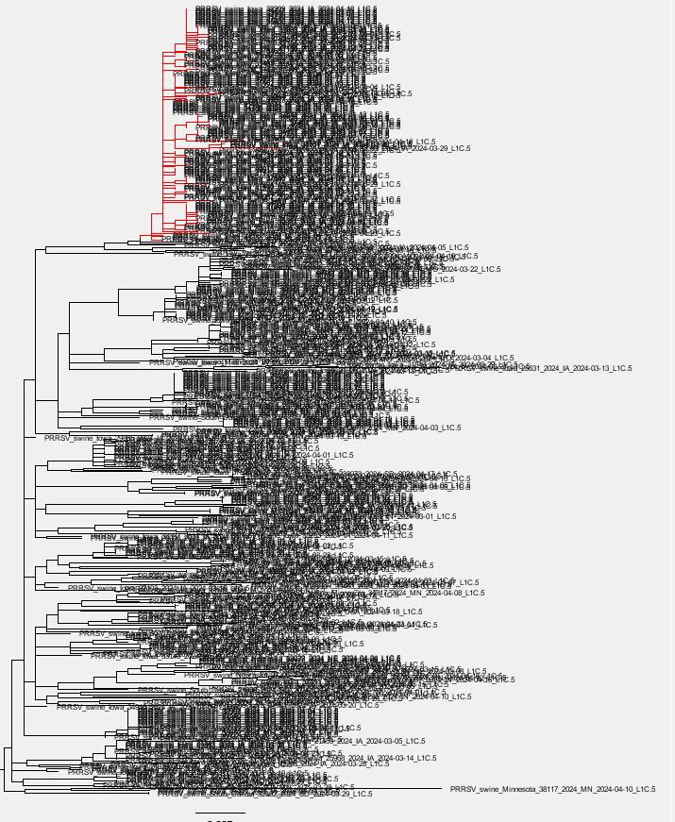
Clonal expansion in L1C.5
Clonal expansion of L1C.5
Genetically similar cases
Overall diversity decreased
Frequent detection of clade
Notes:
Finally, I will talk about an ongoing case involving an L1C.5 clonal expansion
This case was made evident based on the phylogenetic tree pattern, which are regularly updated and monitored. There appeared to be a third vaccine in use, o the tree it had little genetic divergenece.

Slide 19
Clonal expansion in L1C.5
Diversity (Effective pop size)
All L1C.5
Expanding
Clade
Date
Notes:
We had known prior that diversity within the L1C.5 appeared to be contracting, but the number of detections were not going down.
Majority of diversity was from the expanding clade

Slide 20
Clonal expansion in L1C.5
State | Count
IA | 479
IL | 12
IN | 1
MN | 5
MO | 1
NE | 1
USA | 20
Total | 519
Count
Date
Notes:
Rapid expansion of the clade, especially in February and March
While the case numbers went down, it still made a large percent of detections as these were the summer months.
Geographically, this seems primarily concentrated in Iowa, though some cases have been in Illinois
Currently we are following up on it to determine the meaning and signifigance

Slide 21
Summary
Prerequisites for genomic surveillance
  Ingesting, standardizing, and storing data
Applications of genomic surveillance
  Identifying species spillovers
    Risk endemic spread
  Identifying reassortment
    Consequential phenotypical change
  Changes in lineage dominance over time
  Emergence of new variants

Slide 22
Thank you
Contact
mazeller@iastate.edu
Diversity (Effective pop size)
All L1C.5
Expanding
Clade
Date
Notes:
I would like to thank you for your time. My contact information is listed, and I will take any questions.

